Slide 1
《Raft Refloated: Do We Have Consensus?》
Heidi Howard Malte Schwarzkopf Anil Madhavapeddy Jon Crowcroft
University of Cambridge Computer Laboratory

Slide 2
Abstract
Raft is a new consensus protocol that is understandable
with no loss of performance or accuracy：
·Repeat the performance analysis.
·Developed a clean-slate implementation and built an event-driven simulation framework .
·Propose several optimizations to the Raft protocol and demonstrate their effectiveness under contention.
·Empirically validate the correctness of the Raft protocol invariants and evaluate Raft’s understandability claims.

Slide 3
Introduction
· The inherent complexity of distributed consensus hampers their understandability, and complex configuration makes it challenging to replicate experimental setups exactly.
· Paxos is the "gold standard" algorithm in distributed consensus , but its under-specification has led to divergent interpretations and implementations , and hardly
any implementations are publicly available.
· Raft is a new distributed consensus protocol that was designed to address these problems. But we don't know if it has the advantages the author claims.
Notes:
1.构建了一个全新实现，来测试协议的可理解性
2.用自己的经验用自己的话详细描述协议，明确处理协议的微妙之处
3.开发了一个事件驱动的分布式系统模拟器，模拟了原始论文的实验
4.总结了测试过程，并与之前的研究进行了

Slide 4
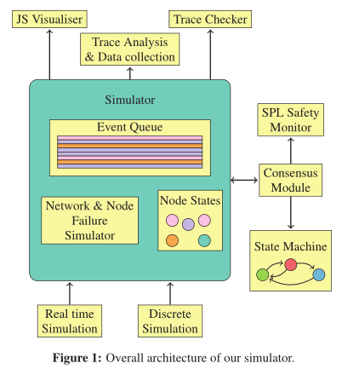
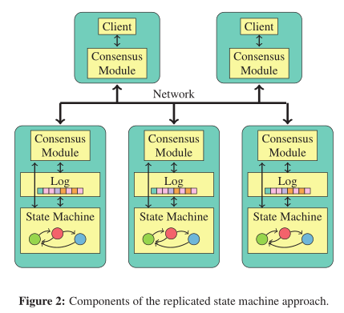
Introduction
Notes:
1.Trace Checker使用模拟器的集群整体视图来验证协议的安全保证
2.SPL将Raft节点建模为非确定性有限状态自动机

Slide 5
BackGround
· Raft consensus operates under the same set of assumptions as Multi-Paxos.
1. The distributed system is asynchronous.
2. Network communication between nodes is unreliable.
3. Byzantine failures cannot occur.
4. Clients must communicate with the cluster via the current leader.
· Furthermore, Raft makes the following implementation assumptions, some of which
can be relaxed with further engineering effort:
1. The protocol has access to infinitely large, monotonically increasing values
2. The state machines running on each node all start in the same state and respond deterministically
to client operations;
3. The storage is infinite and can’t be corrupted, and using WAL.
4. Nodes are statically configured with a knowledge of all other nodes in the cluster

Slide 6
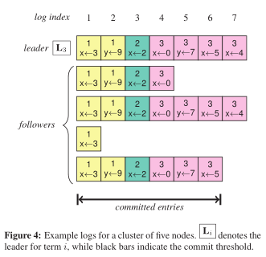
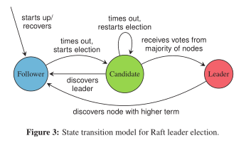
BackGround

Slide 7
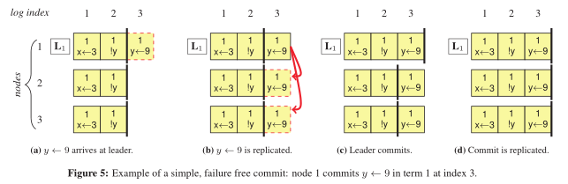
BackGround

Slide 8
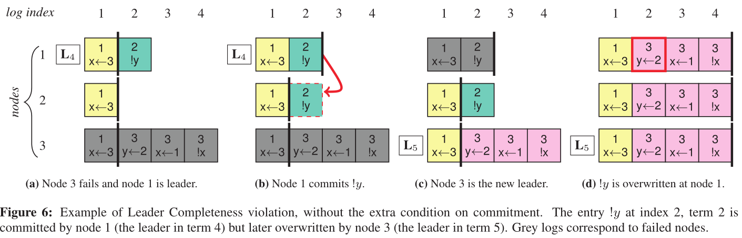
BackGround

Slide 9
Implementation
· Using a modular OCaml-based approach, we: (i) separated the Raft protocol’s state
transitions; and (ii) built domain-specific frontends such as trace checker and simulation framework.
· Simulator supports Discrete Event Simulation (DES) and Real-time Event Simulation (RES) to vary the trade-off between simulation accuracy and time.

Slide 10
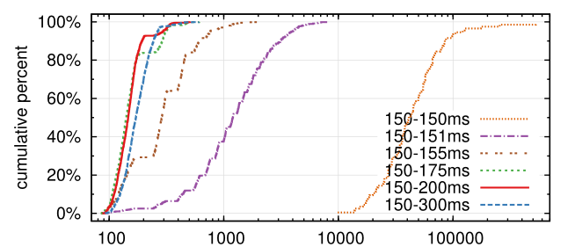
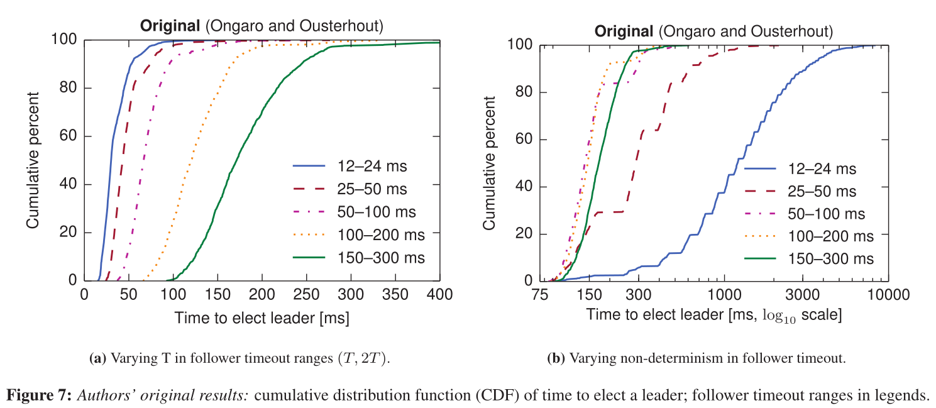
Results
· Original Results

Slide 11
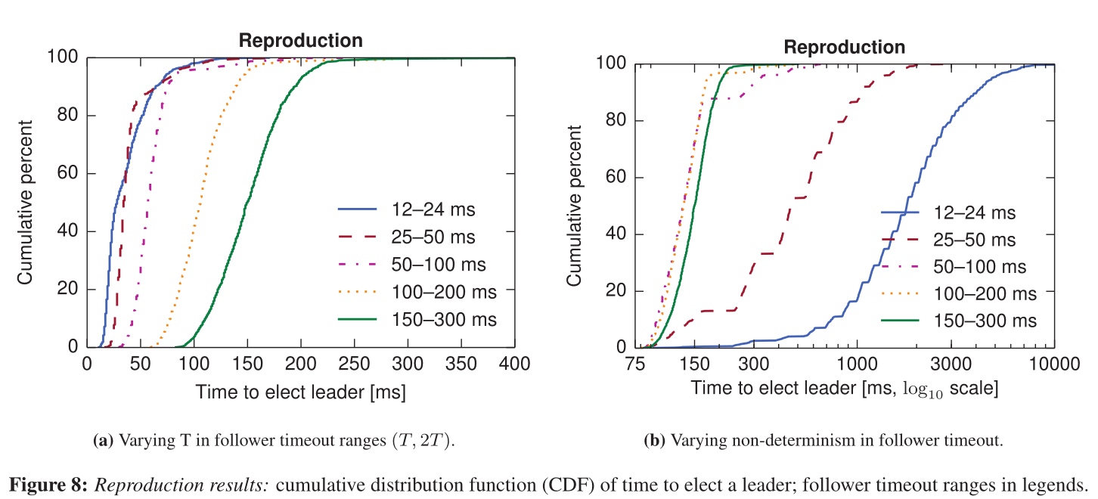
Results
· Reproduction Results

Slide 12
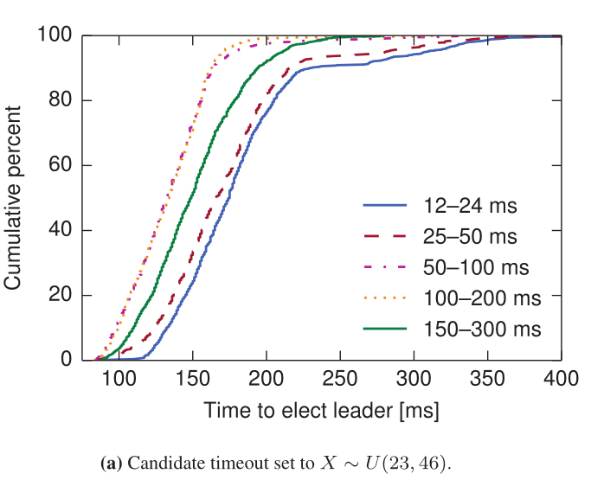
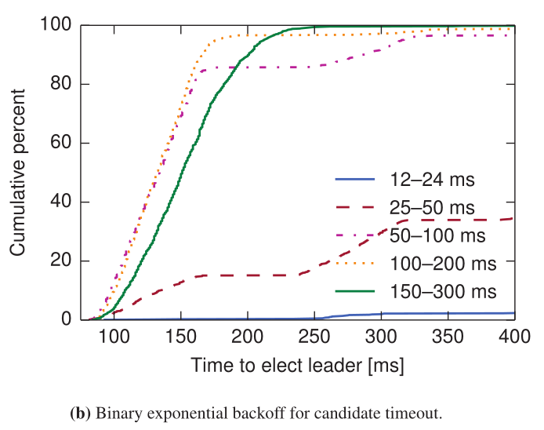
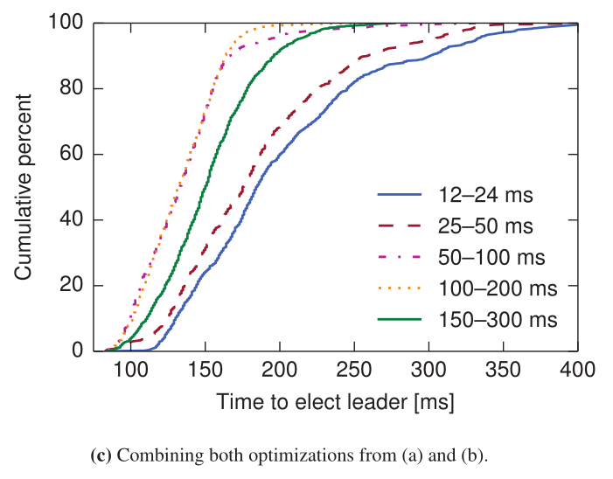
Results
· Optimization
1.Different Follower and Candidate Timers.
2. Binary Exponential Backoff.

Slide 13

Q & A
Thank You!

